Slide 1
Import data from the
text and csv
Import data from the
text and csv

Slide 2
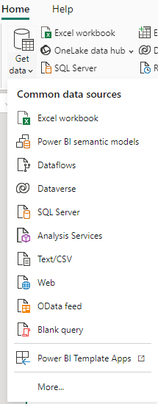
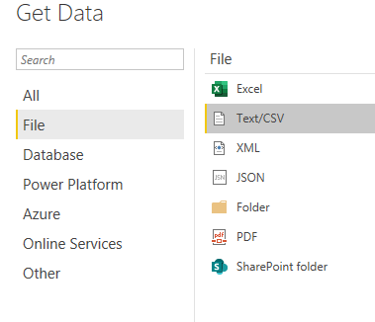
Import text and CSV
Note: This lab uses the CSV files located in \ resources \ CSVSource .
Choose the data source from the More... menu .
2
1

Slide 3
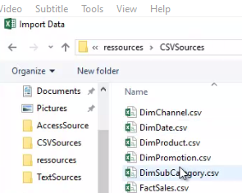
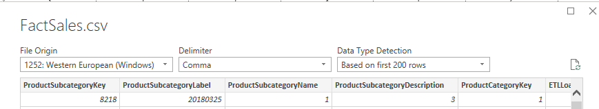
Import text and CSV
Navigate to the folder containing the CSV files, select FactSales.csv , and then click Upload .
The Unicode used.
The column separator used in the CSV file.
The option to load the first 200 rows or all data .
Notice the three fields at the top of the table.
1
2
3

Slide 4
Import text and CSV
Also notice the buttons at the bottom of the window.
4
5
6
Load data immediately into Power BI.
Switch to the Power Query editor before loading data to transform it.
Cancel the import.
Repeat the same procedure with the other CSV files. Then, select the Template menu on the far left and notice that there is no
no link between imported tables, unlike the previous lab.

Slide 5
Import text and CSV
Also notice the buttons at the bottom of the window.
4
5
6
Load data immediately into Power BI.
Switch to the Power Query editor before loading data to transform it.
Cancel the import.
Repeat the same procedure with the other CSV files. Then, select the Template menu on the far left and notice that there is no
no link between imported tables, unlike the previous lab.

Slide 6
THANKS
THANKS

